Slide 1
Developing SPAs with React and JSX/TSX
Notes:
This module introduces students to React.js and examines how React.js uses a component-based architecture and a virtual DOM to optimize performance. Students will learn to create and configure new Node.js projects as a Single Page Application (SPA) using React.js together with TypeScript and Webpack. The module walks through how to design an SPA by creating a hierarchy of React components which define properties, state and event handlers. The module introduces JSX and teaches students the essential concepts and syntax for writing TypeScript code in a TSX file to generate the HTML for a React component. Along the way, students will learn how to integrate the React Router into an SPA project to provide navigation across multiple views.

Slide 2
Agenda
Getting Started with React.js
Creating SPAs using React.js, TypeScript and Webpack
Designing a React Component Hierarchy
Extending a React Project with the React Router
Understanding the React Component Lifecycle Methods
Calling Across the Network using the Fetch API

Slide 3
Introducing React
React is a library for building user interfaces
Not as all-encompassing as a framework like Angular
Focused on building HTML-based user experiences
Based on reusable component-based architecture
Components react to state changes by updating UI
React uses shadow DOM for efficient event handling
React was originally designed for Facebook
Also a good fit for building SPFx web parts

Slide 4
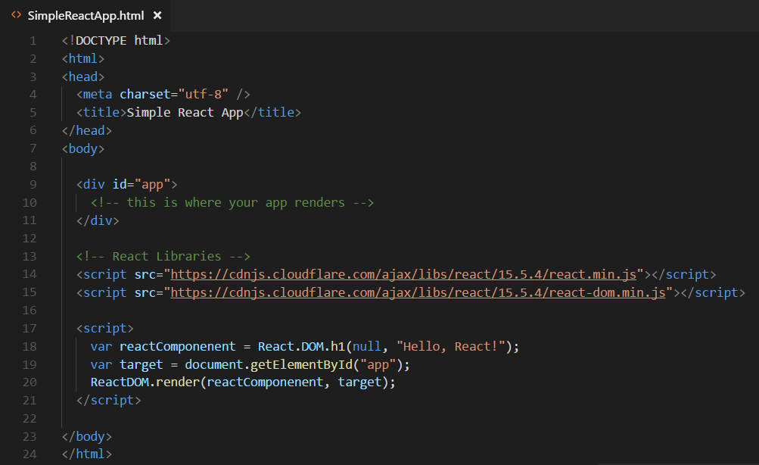

Hello World with React.js
Obtain the React library with npm or from a CDN
npm install react --save
npm install react-dom --save

Slide 5
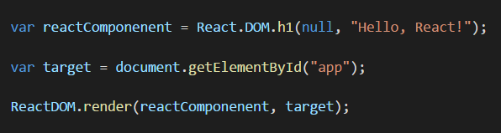
React versus ReactDOM
React and ReactDOM are separate libraries
React (react.js) is the primary library used to build out user experiences
ReactDOM (react-dom.js) is used to render React user experience in the browser
React library exposes global React object
React object is the main entry point into React API
React.DOM wraps standard HTML elements
ReactDOM library exposes global ReactDOM object
ReactDOM object used to render React components on web page

Slide 6
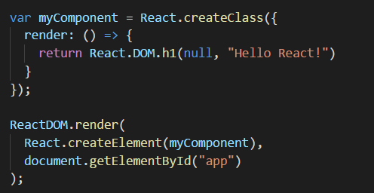
React Component Created Using ES5
React component can be created using EcmaScript 5
React component definition created using React.createClass
React component must be defined with render method
React component can be instantiated with React.createElement

Slide 7
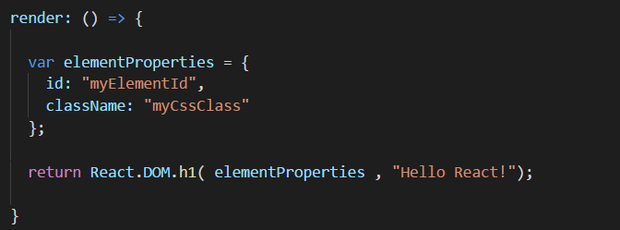
Initializing Element Properties
Elements created using properties object
Object properties used to initialize element properties
Use className instead of class to assign CSS class
Use htmlFor instead of for to define HTML label

Slide 8
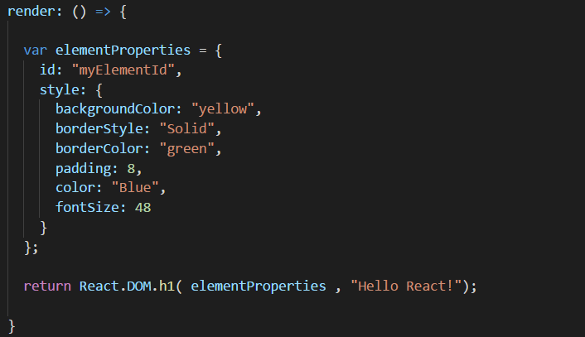
Initializing Element Styles
Elements styles initialized using style object
style must be defined using an object not a string
CSS properties referenced using camel casing

Slide 9
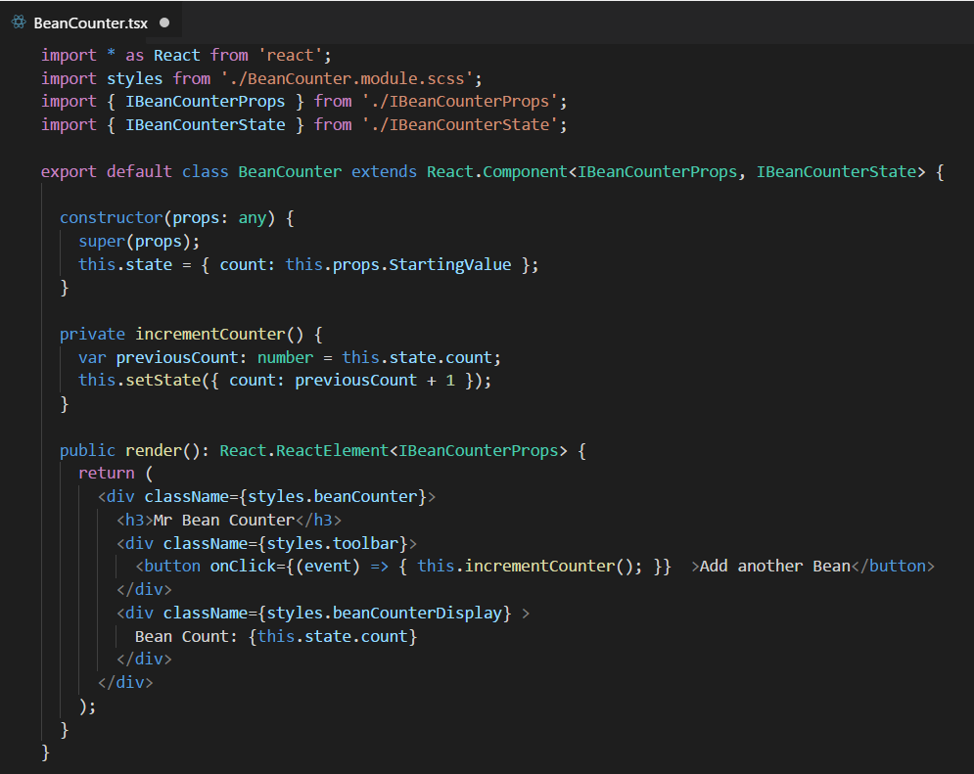
React Provides Synthetic Events
Replaces standard DOM-based event handling
React creates virtual DOM for elements in component
React interacts with real DOM when required
Provides faster event registration and processing
No need to write browser-specific code

Slide 10
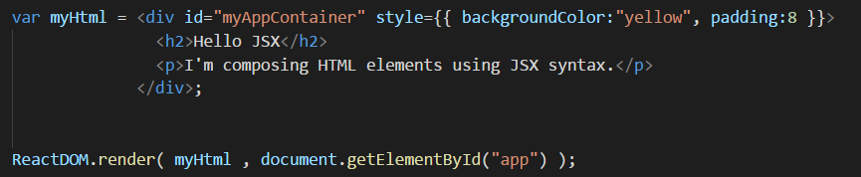
Understanding JSX (and TSX)
JSX provides better syntax for HTML composition
JSX allows extends JavaScript with XML-like syntax
JSX syntax must be transpiled into JavaScript code
JSX/TSX is separate from React library
JSX/TSX commonly used in React development
Babel compiler used to transpile JSX to JavaScript
TypeScript compiler used to transpile TSX to JavaScript

Slide 11
Agenda
Getting Started with React.js
Creating SPAs using React.js, TypeScript and Webpack
Designing a React Component Hierarchy
Extending a React Project with the React Router
Understanding the React Component Lifecycle Methods
Calling Across the Network using the Fetch API

Slide 12
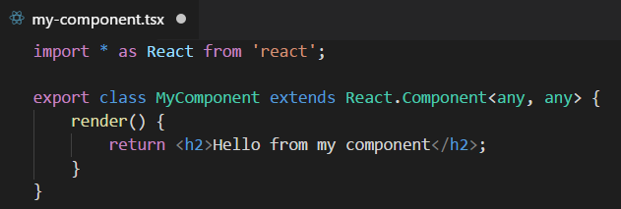
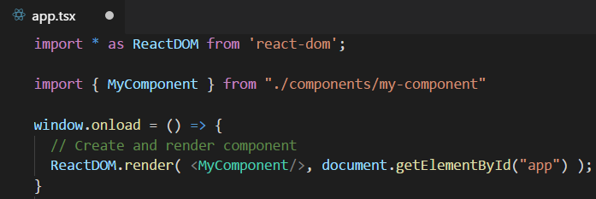
Defining React Components using TypeScript
Component is class extending React.Component
Component usually defined in its own tsx file
Component class must define render method
Component can be instantiated with JSX/TSX syntax

Slide 13
Component Properties and State
Component can contain properties and state
Properties are initialized by external components
Properties are read-only to hosting component
State is set internally by hosting component
Changing state triggers UI refresh by calling render
UI experience created by reacting to changes in state

Slide 14
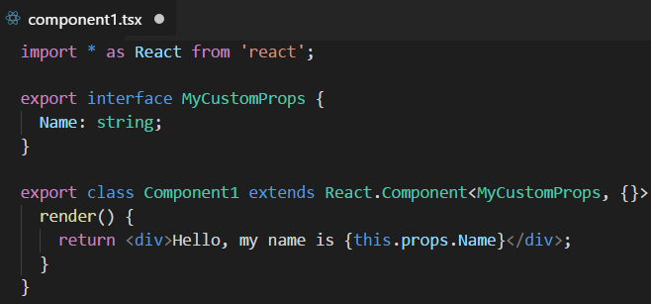
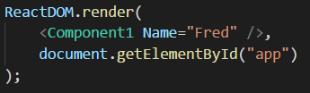
React Component Properties
Defining component with a property
Instantiating component with a property

Slide 15
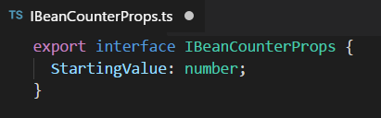
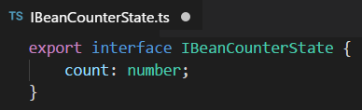
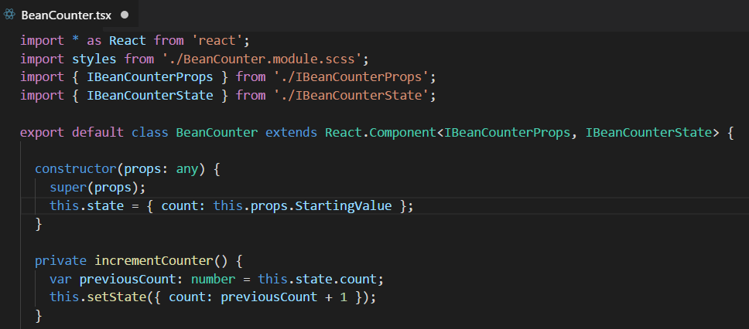
Stateful Component

Slide 16
Stateful Component Rendering

Slide 17
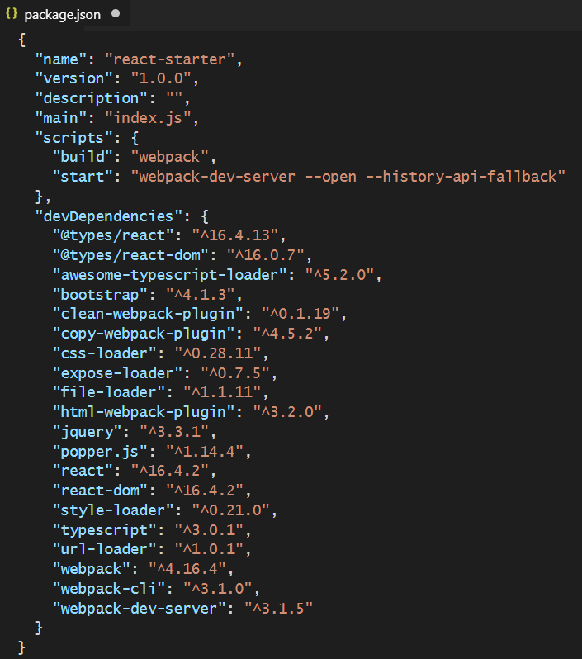
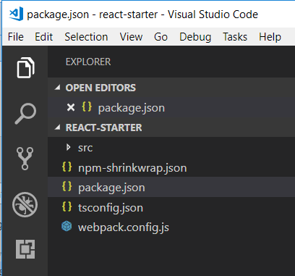
Starter Project - package.json

Slide 18
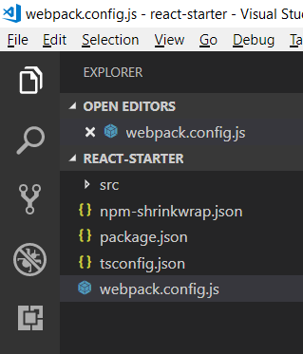
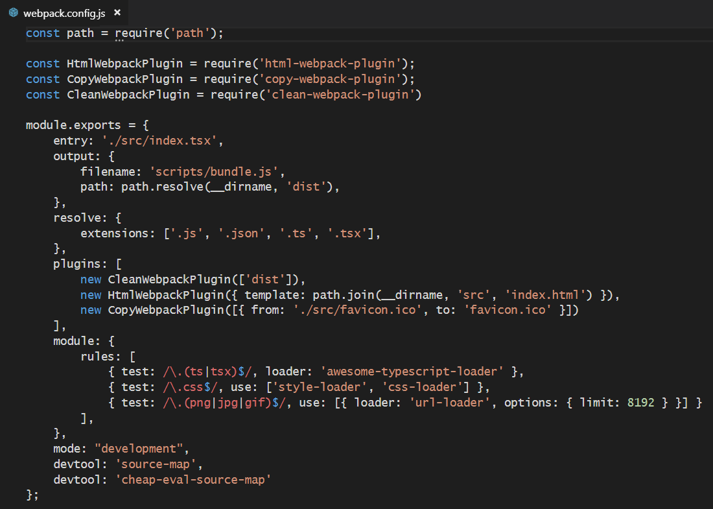
Starter Project - webpack.config.js

Slide 19
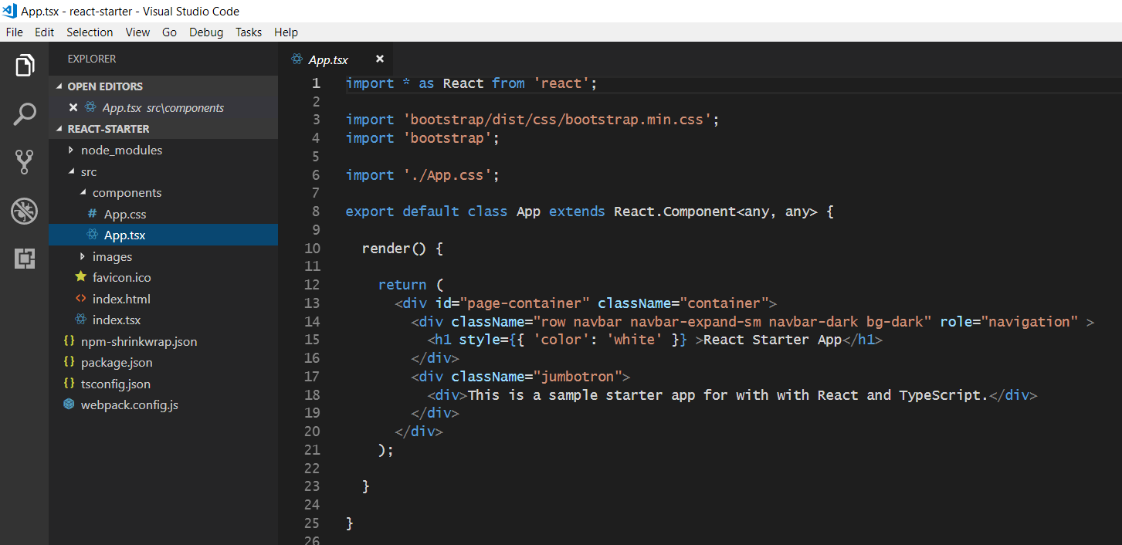
The Top-level App Component

Slide 20
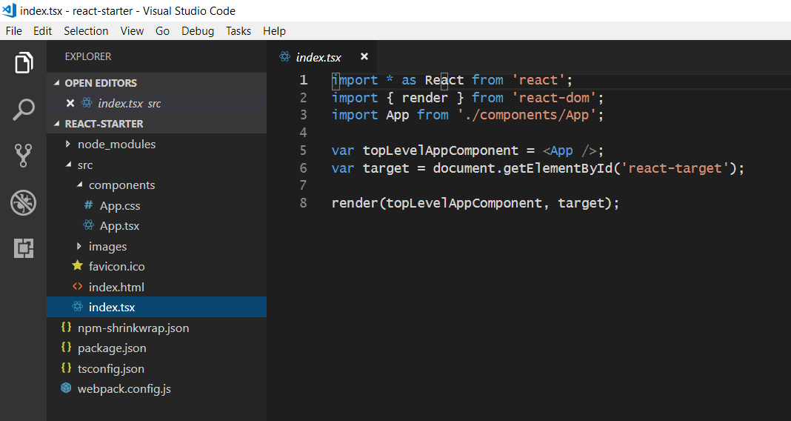
Bootstrapping the App Component

Slide 21
Agenda
Getting Started with React.js
Creating SPAs using React.js, TypeScript and Webpack
Designing a React Component Hierarchy
Extending a React Project with the React Router
Understanding the React Component Lifecycle Methods
Calling Across the Network using the Fetch API

Slide 22
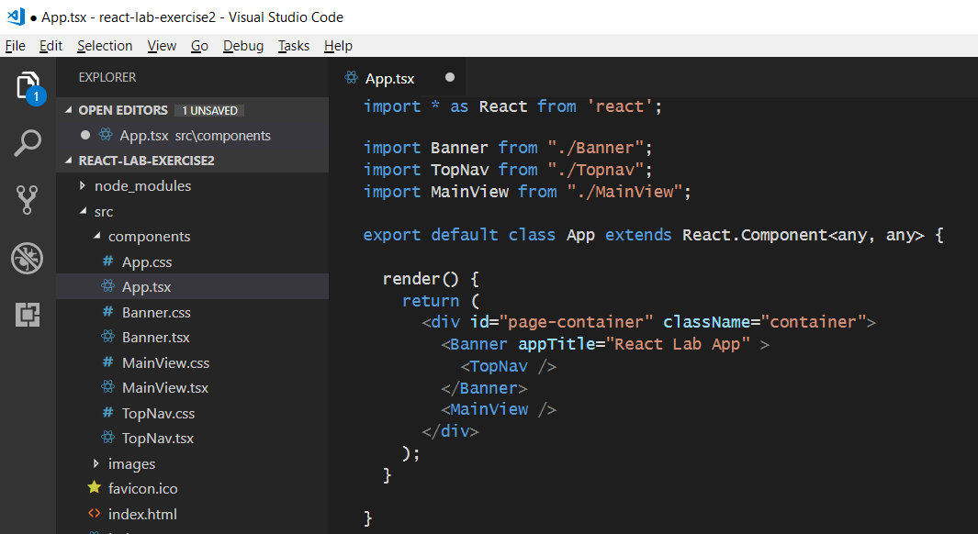
React Component Hierarchies
App
Banner
Topnav
MainView

Slide 23
Agenda
Getting Started with React.js
Creating SPAs using React.js, TypeScript and Webpack
Designing a React Component Hierarchy
Extending a React Project with the React Router
Understanding the React Component Lifecycle Methods
Calling Across the Network using the Fetch API

Slide 24
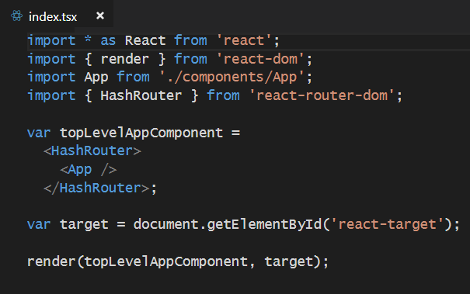
React Router
Used to create route map in single page application (SPA)
Installed as a pair of npm packages
npm install react-router @types/react-router --save-dev
npm install react-router-dom @types/react-router-dom --save-dev
Router must be added in as top-level component above App

Slide 25

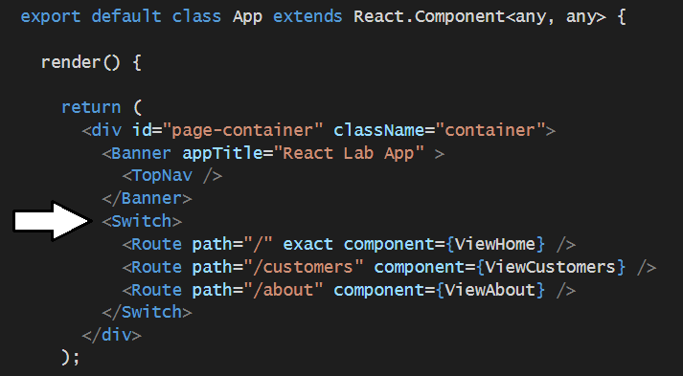
Using React Router
Import Route and Switch components
Create route map in HTML output

Slide 26
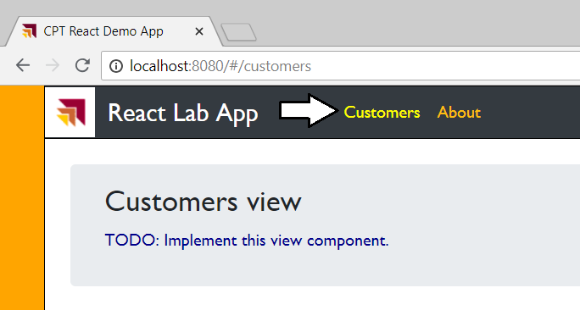
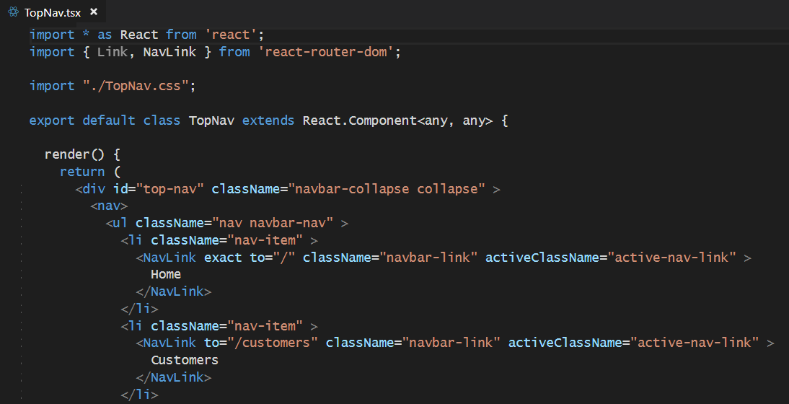
Creating Route Links

Slide 27
Agenda
Getting Started with React.js
Creating SPAs using React.js, TypeScript and Webpack
Designing a React Component Hierarchy
Extending a React Project with the React Router
Understanding the React Component Lifecycle Methods
Calling Across the Network using the Fetch API

Slide 28
Component Lifecycle
componentWillUpdate
executed before component is rendered
componentDidUpdate
executed after component is rendered
componentWillMount
executed before node is added to the DOM
componentDidMount
executed after node is added to the DOM
componentWillUnmount
executed before node is removed from the DOM
shouldComponentUpdate(newProps, newState)
executed before component is updated

Slide 29
Agenda
Getting Started with React.js
Creating SPAs using React.js, TypeScript and Webpack
Designing a React Component Hierarchy
Extending a React Project with the React Router
Understanding the React Component Lifecycle Methods
Calling Across the Network using the Fetch API

Slide 30
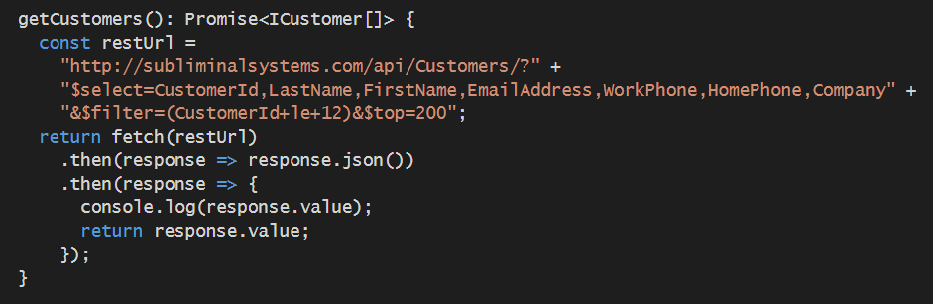
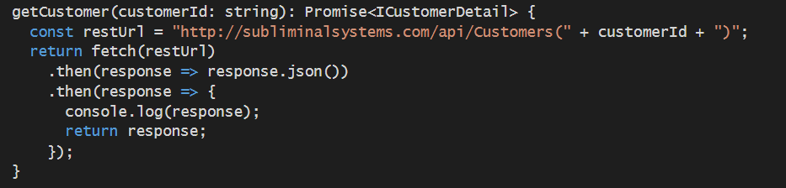
Calling a Web Service using the Fetch API

Slide 31
Summary
Getting Started with React.js
Creating SPAs using React.js, TypeScript and Webpack
Designing a React Component Hierarchy
Extending a React Project with the React Router
Understanding the React Component Lifecycle Methods
Calling Across the Network using the Fetch API

